Slide 1
Geo-replication
a journey from the simple to the optimal
Faisal Nawab
In collaboration with:
Divy Agrawal, Amr El Abbadi, Vaibhav Arora, Hatem Mahmoud, Alex Pucher
(UC Santa Barbara)
Aaron Elmore (U. of Chicago) Stacy Patterson (Rensselaer Polytechnic Institute)
Ken Salem (U. of Waterloo)

Slide 2
Geo-replication
X
A
A
B
B
C
C
Datacenter California
Datacenter Virginia

Slide 3
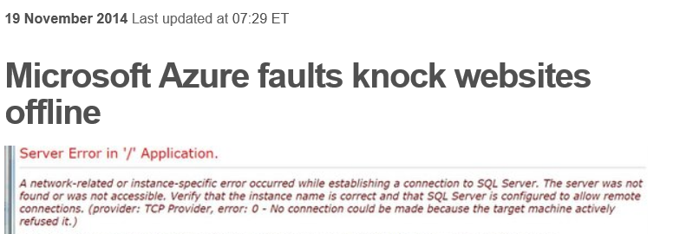

Slide 4
Geo-replication has challenges
Wide-area latency
Coordination is expensive
Consistency guarantees
Transactions support

Slide 5
~10 years ago – NoSQL
No transactions support
Weaker consistency guarantees
Transactions and guarantees are often needed
Developer builds own (transactional) solution
Error-prone process
Reinventing the wheel
BUT

Slide 6
~4 years ago – bringing back transactions
We want our transactions!
Megastore [CIDR’2011], Spanner [OSDI’12], MDCC [EuroSys’13]
A journey from the simple to the optimal
Paxos-CP [VLDB’12]
Message Futures [CIDR’13]
Chariots [EDBT’15]
Replicated Commit [VLDB’13]
Helios [SIGMOD’15]
2012
2015

Slide 7
Transactions

Slide 8
Transactions
A collection of read and write operations
Atomicity, Consistency, Isolation, Durability
Abstract as a set of reads and writes
Guarantee the “illusion” of a serial execution
Remaining = Read (T)
If (Remaining>N)
Write(X, Remaining-N)
Process payment
Else
fail
Buy N tickets
Read (T)
Write (T, new value)
Purchase (N)

Slide 9
Transactions
Why “Guarantee the illusion of a serial execution”?
Remaining = Read (#Tickets)
Write (#Tickets, 1)
Process payment
Buy 3 tickets
Remaining = Read (#Tickets)
Write (#Tickets, 2)
Process payment
Buy 2 tickets
4
1

Slide 10
Spanner [OSDI’12]

Slide 11
Spanner [OSDI’12]
Google’s solution for geo-replication
Commit protocol (2PC/Paxos)
Each partition has a leader
Two-Phase Commit (2PC) across partition leaders
Paxos to replicate each step of 2PC
A
B
A
B
C
C

Slide 12
Transaction latency
Read requests
2PC message
Paxos message
A
B
A
B
C
C
Datacenter California
Datacenter Virginia
Read (2)
Send prepare (1)
Replicate (2)
Receive prepare (1)
Replicate (2)
Commit (0)

Slide 13
Effective geo-replication
Spanner proved an effective geo-scale model
High throughput
Fault-tolerance
Serializable transactions
It also illuminated a challenge of geo-replication
Wide-area latency
Leads to high transaction latency

Slide 14
wide-area latency
awareness
[VLDB’13]

Slide 15
Wide-area latency awareness
Inter-datacenter latency is much higher than intra-datacenter latency
Intra-datacenter latency: ~ 1-2 milliseconds
Inter-datacenter latency: 10s to 100s milliseconds
Inter-datacenter rounds of communication are expensive
Avoid them!
Replicated Commit [VLDB’13]
Majority voting algorithm for the geo-replication framework
The datacenter is the machine

Slide 16
Replicated Commit [VLDB’13]
Read requests
Voting messages
Locking messages
A
B
A
B
C
C
Datacenter California
Datacenter Virginia
Read (2)
Voting request (1)
Locks (0)
Voting (1)
Commit (0)

Slide 17
Latency performance
Latency depends on the network topology
Read operations
Replicated commit: majority
2PC/Paxos: read from leader
Commit phase
Replicated commit: 1 round to majority
Spanner: 1 round to leaders + majority round from leaders

Slide 18
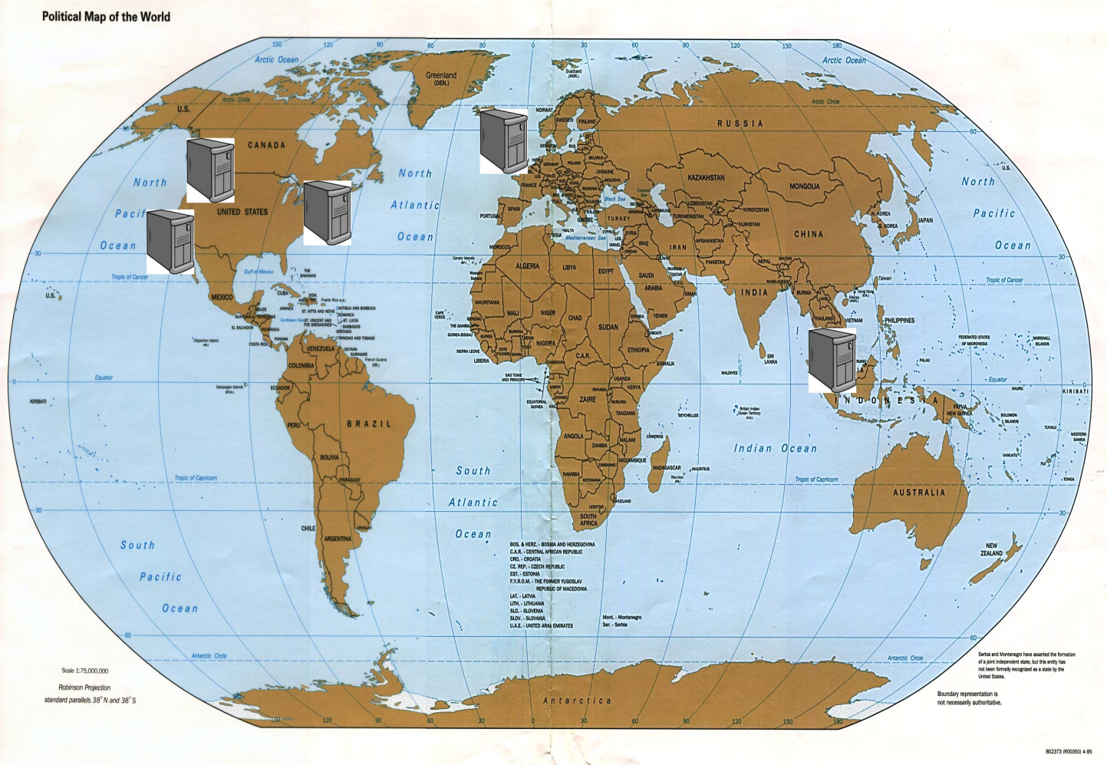
Performance
Five data centers
Data into 3 partitions
YCSB clients at each data center
Show average commit latency (ms)
403
167
337
92
Replicated Commit
2PC/Paxos

Slide 19
“Can we break the
RTT barrier?”
[CIDR’2013]

Slide 20
Decoupling consistency and fault-tolerance
Decouple consistency and fault-tolerance
Protocols to ensure consistency only
Augment with fault-tolerance later
Message Futures [CIDR’13]
A causally ordered log is leveraged

Slide 21
Message Futures
Simple case: Ping ponging log propagations
Commit rule: (1) wait until next log is received
(2) detect conflicts with coming log.
A
txn
Commit
Latency less than RTT
B

Slide 22
Message Futures
General case: Continuous log propagations
Commit rule: (1) wait until previous log transmission is acknowledged
(2) detect conflicts with coming log
For arbitrary log propagation
Control relative performance by controlling propagation rates
A
txn
Commit
B

Slide 23
“Is there a lower-bound
on transaction latency?”
[SIGMOD’15]

Slide 24
T1 requests to commit
T1 commits
A
T1 latency
B
Events can affect outcome of T1
Events can be affected by T1
T2 latency
Transaction T2
Commit latency of A + Commit latency of B must be greater than or equal the Round-Trip Time between them

Slide 25
Optimal latency
Lower bound:
Latency(A) + Latency(B) > RTT(A,B)
A
30
20
B
C
40
Minimize (sum of latencies)
Subject to (1) Latency(A) + Latency (B) > RTT(A,B), for all A,B
(2) Latency (A) >= 0, for all A

Slide 26
Optimal latency
A
30
20
B
C
40
Protocol | Latency(A) | Latency(B) | Latency(C) | Average
Leader-based (Leader A) | 0 | 30 | 20 | 16.67
Leader-based (Leader C) | 20 | 40 | 0 | 20
Majority | 20 | 30 | 20 | 23.33
Optimal | 5 | 25 | 15 | 15

Slide 27
Achieving the lower-bound
[SIGMOD’15]

Slide 28
Helios
insight from the lower-bound
T1 requests to commit
T1 commits
A
B
Events can affect outcome of T1
Events can be affected by T1
Transaction T2

Slide 29
Helios commit protocol
Time=5
Time=15
Latency= 10
A
RTT=16
Latency= 6
B
Time=7
Time=13

Slide 30
Wide-area latency awareness
Lower-bound on transaction latency
Thinking outside
the box -- Cross-layer solution
Systems are more than transaction latency numbers

